Slide 1
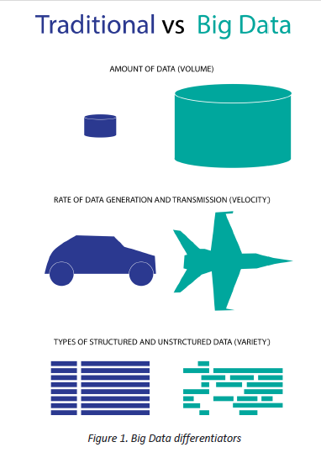
Definition
The term Big Data refers to large-scale information management and analysis technologies that exceed the capability of traditional data processing technologies.1 Big Data is differentiated from traditional technologies in three ways:
the amount of data (volume),
the rate of data generation and transmission (velocity),
and the types of structured and unstructured data (variety) (Laney, 2001) (Figure 1).
Notes:
They have
very large subscriber bases, and data is generated every time a
customer makes a call, creates a text or uses the Internet. This
data provides information about who customers called, what
web sites were visited, which apps were downloaded, where the
customer was when the phone was used, as well as his or her
current location. The data also provides valuable information
about the customer experience. Did the call go through? Was it
dropped or interrupted? How fast did the song or app
download? What was the response latency during the game
that was played?

Slide 2
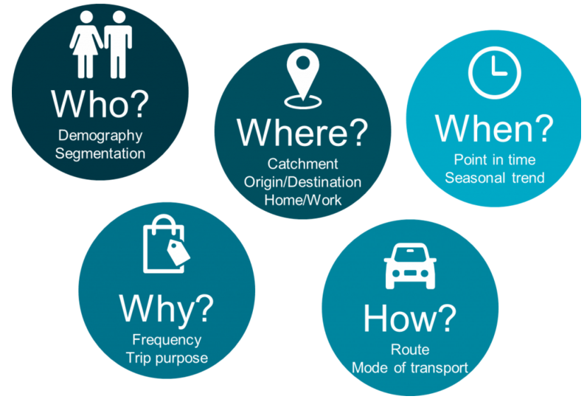
Telefonica O2 – Smart Steps

Slide 3
Telefonica O2 – Smart Steps
Telefonica uses Smart Steps to :
Measure/ Compare/ Understand factors => no. of visits to a location
Finding trends and locations for new retail outlets.
Study the effectiveness of new policies.
Notes:
Measure/ Compare/ Understand what factors influences number of ppl visiting a location at any time
Gains insights to tailor local offerings for existing stores & determines best location and most appropriate formats for new stores.
Help government measures traffic after implementation of new rules. E.g. Free car parking, farmer markets or late night shopping.

Slide 4
Implication for Starhub
Measures impact of decisions
Measures store performance
Predict demand
Understanding location
Notes:
Measures impact of decisions. Verify the impact that your decision on your outlets to minimize costs of implementation and strategic planning.
Measures store performance. Compare different stores, different locations, advertising policies , promotions campaigns to establish new effective ways to measure their performance. Understanding which sites have the highest frequency of visits vs frequency of purchase (revenue), and which locations have the most loyal customers.
Predict demand. Gain insights in planning for peak and troughs in demand to ensure the stores have the right resources available at the right time, this will ensure Just-In-Time Inventory. Cutting the storage cost, lower inventories holding at anytime. Furthermore, reduce the churn number due to low quality service, especially important for perishable products.
Understanding location- Enable more informed decisions on investment to certain locations by understanding the profile of the customers in the area, frequency of visits and number of traffic in and out of the location.

Slide 5
Verizon wireless-Precision Market Insights
Able to extract:
National population
Locations
Demographic
Usage Data
Target audience: Media owners, sponsors, advertisers, venue owners and retailers.
Notes:
Precision Market Insights partners with BlueKai, the data management provider; Brightroll, a video ad platform; and the programmatic ad tech providers RUN and Turn.
The four will now sell its tool to advertisers for mobile ad campaigns that target Verizon's massive subscriber base based on demographics, interests and geography.
Employing Anonymous Targeting called PrecisionID. When consumers visit certain websites or mobile apps, a request is sent through a Verizon network. Precision packages the request, as a hashed, aggregated and anonymous unique identifier, and turns it into a lucrative chunk of data for advertisers.

Slide 6
Singtel- Amobee Acquisition
Purpose: better reach
How?
Push relevant offers
Rewards and promotions to customers.
Notes:
Singtel, on the other hand, takes a different approach to the matter by acquiring a mobile advertising firm Amobee. A vertical integration approach would allows Singtel to potentially enhance the capacities of Singtel Group operators in the Asia market in the emerging digital marketing technolocy, as well as creating a big opportunities for SingTel in emerging markets, such as India, Indonesia, Thailand and the Philippines.
According to Singtel:
Singtel already has advanced geo-localisation capabilities, as well as the means to empower customers to receive only relevant and customised offers and promotions catering to their needs and preferences while protecting their privacy. Furthermore, Singtel’s access to the Group’s over 400 million mobile customers offers a compelling proposition for brands wanting to reach customers in the emerging markets. Amobee complements these capabilities with a strong technical platform that serves ads, banner as well as video ads and an experienced team in mobile advertising.

Slide 7
Implication for Starhub
Measure advertising performance.
Finding effective advertising flatform.
Advertising content based on location.
Personalized deals, offers, promotions and coupons.
Notes:
Measure advertising performance at particular location by determining the rate of visits, the increase in number of visits to outlets, analyze competitor activities as well. This would allows a more informed understanding for the return of investment in advertising campaign.
Finding effective advertising flatform. Potentially, identify location and match with particular demographic, time of the day for product pricing in Singapore, which is applicable for outdoor billboard, banners, advertising screen.
Advertising content based on location. Meaning, social media, websites and online content can be tailored to for advertising based on location of the person by showing near by promotions, discount, sales, or items of interest to the users based on their browsing pattern.
Personalized deals, offers, promotions and coupons. Advanced analytic would enable Starhub to engage in personalized offers and promotions, which helps to increase customers satisfactions and reduce spamming which eventually reduces churning.
Advertisers partnering with Starhub could reach specific demographic segments on mobile, identify and serve ads to loyal customers, and re-target particular users based on our Data Science and Data Solution team.

Slide 8
INSURANCE COMPANY
“If I’m an insurer that wants to accurately price insurance coverage on a particular house, I need to know, are you in an earthquake zone, a flood zone, or are you in an area that is prone to wildfires,” says Bill Sinn, marketing director for insurance and healthcare at Pitney Bowes. “And, if I know a major storm is approaching I want to know, with precision, that I’ve got 50,000 policy holders that could be impacted.”
Sinn says that products like MapInfo Professional, which allow users to visualize geospatial data, have revolutionized the way insurance underwriters, actuaries, claims, and marketing professionals utilize the information. “Underwriters previously had to look at a spreadsheet,” Sinn says. “But now they can visualize it and look spatially and say, how many other policy holders do I have near that location?” While data used to be broken down by zip code, Sinn notes that MapInfo Professional lets users drop a pin in a location and then micro-analyze data however they choose—for example, by creating a mile-radius ring around the projected storm path.

Slide 9
Banking
“Let’s say, as a regional manager, you select a specific branch in Boston, and through a better understanding of its trade area you can assess its relative performance,” says Clarence Hempfield, director of product management for Pitney Bowes. “Based on an understanding of the demographic profile of the area which suggests that there is $100 million worth of potential business in the area, but the branch is only generating $25 million. Further evaluation can be conducted to better understand this shortfall. The regional manager could re-evaluate local leadership, the mix of products/services offered in that branch, better understand competitive positions within the market, and/or reassess the targets for that branch.”
Banks and credit card companies can also use location intelligence tools to better detect fraud, and also avoid flagging legitimate charges as potentially fraudulent. “As they start to develop profiles of where you shop, that makes it a bit cleaner to anticipate charges that on the surface might seem a bit outside the norm,” says Hempfield. “There’s nothing worse than when a customer tries to buy a plane ticket, and the bank, because the airline’s call center is in a different state or country, thinks it’s an illegitimate charge and rejects the purchase.”
Hempfield explains how financial institutions can use geospatial data to electronically send their cardholders special offers when they’re at or near specific stores. “Banks and credit card companies want to help drive additional business to their network of retailers,” Hempfield says. “Part of the way they can do that is to give consumers incentives to shop at those retailers. Understanding where customers routinely shop and the types of products they routinely buy, enables the financial institution to make targeted offers that create an incentive for the consumer to shop within its network of retailers, while utilizing their credit/debit card.”

Slide 10
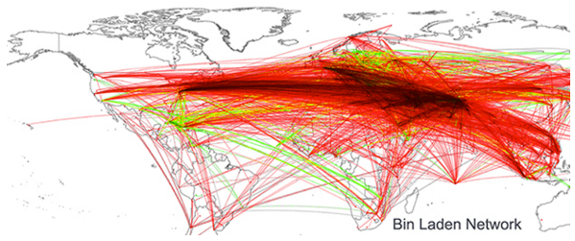
Government - Politics
Criminal activities and security protection
Using location-based report to predict political events
Notes:
Criminal activities and security protection. For instance, University of Illinois computer scientist Kalev Leetaru, written about being able to locate Osama Bin Laden’s location based on mining news report, basically, he connected cities together if they were mentioned in a same article. Then he ended up with the map as seen below, all roads lead to a 200-kilometer radius about Abbottabad. Personally, I would not say this as a reliable way to solve problems, however, this type of new research and studies on human behavior could potentially lead to exciting field of getting political intelligence.
Using location-based report to predict political events: Futhermore, predictive models can be built with data from social media conversations, mobile phones and browsing behavior. Potential illegal activities, gathering can be identify and prevented. Furthermore, historical data might as well give insights into potential triggers for such events in the future.

Slide 11
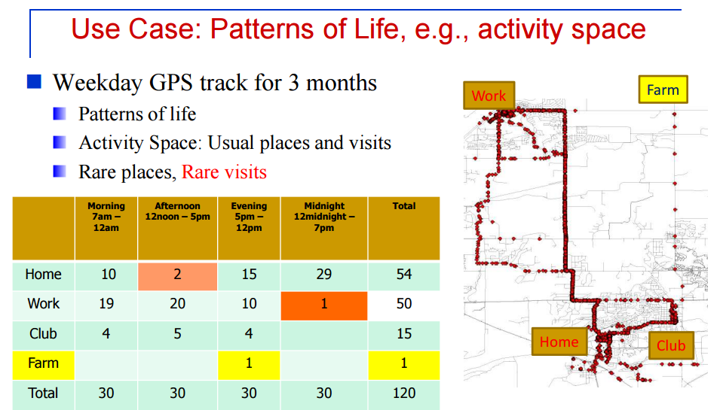
Notes:
As seen from the photo, a precise and periodic behavior/ schedule of an individual could be map and record to accurate level during a day. By studying the activity of potential datapoint within the dangerous area, we could identify potential criminal activities, etc.

Slide 12
Government- traffic
Target: City Management & midsize utilities
Purpose: better evaluate patterns and trends to improve urban planning, utilities can better manage their equipment to reduce cost
Result:
+Better allocation due to incident report.
+Improve traffic flows
+Identify inefficiency
+Updates on road accidents
Notes:
Better allocation and distribution of resources based on information from incidents, service disruption.
Analyzing the movement of people to improve traffic management, park capacity, location, and number of first unit responders. City officials can better prepare and react to potential bottlenecks and other issues in case of an emergency.
Identify inefficient traffic pattern so that they can improve traffic management/ re-rounted/ better allocate public safety resources in places where majority of people congregate.
Monitor social media updates so as to report bad weather, major traffic accidents or traffic jams locations so that the city can take best course of action.

Slide 13
Positioning Data at Starhub
Data as a service.
+ Selling fraction of processed data as the end product.
+ Selling a whole package of aggregated data as the intermediate good. (API)
+ Selling a final product as a report for a particular purpose
Notes:
Selling fraction of processed data- for a particular purpose (such as demographic, crowded area,etc).
Selling a whole package of aggregated data. Which is the entire anonymous location based data of starhub customers. So that the buyers can further extract information or perform analysis so as to gain insights.
Selling a final product as a report for a particular purpose. E.g. Starhub could perform necessary analysis on the data obtained and then only produce the required report that the buyers want.
Furthermore, some side effects from the information could be used to identify out-break of diseases, disaster, unrest and emering hot-spot.

Slide 14
Case 1 : O2 retail smart step case study
Customer:
O2 retails
Industry:
Retail sector
Solution:
Using data to support the theory that the Swindon store was underperforming for its location.
Notes:
O2 Retail approached the Smart Steps team to find out
if they could provide data to support the theory that the
Swindon store was underperforming for its location.

Slide 15

Evaluation Process:
Notes:
Smart Steps uses anonymised
and aggregated mobile network
data from O2’s 23 million
customers. Where traditional
data capture methods are based
on occasional samples, modelled
or claimed behaviour, Smart Steps
takes billions of mobile events on its
network and extrapolates data to
provide insight representative of the
total population in each area.
We ended up with a really clear
understanding of the store’s
catchment and the types of
customers we could expect to
see. Based on that, we sought board
approval for the business case for
expansion. We proposed doubling
the size of the store by expanding
into an adjoining unit, and taking on
more staff.”
Result: In the two months since the store’s
expansion and refit, footfall has
increased by 72% and total sales
are up 14% from the previous store
layout.

Slide 16
Case 2 : IBM bid data in Telecom
Conductor: IBM & Said Business School at University of Oxford.
Industry: Telecommunication
Findings:
Commit initial efforts to customer-centric outcomes
Develop an enterprise-wide big data blueprint
Start with existing data to achieve near-term results
Build analytics based on business priorities
Create a business case based on measurable outcomes.

Slide 17
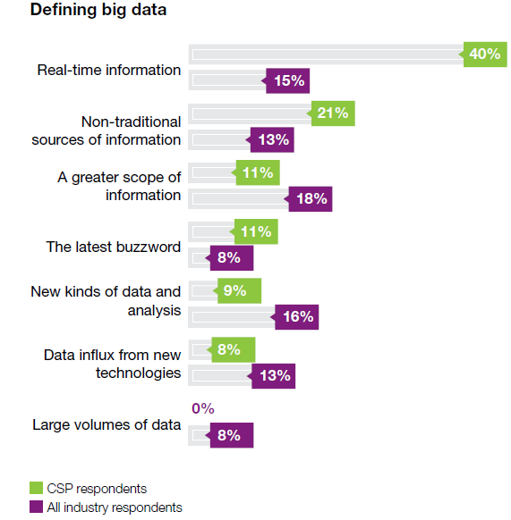
Sample size:
1,144 Business and IT Executives
26 Industries
53 from Telecommunications
Bid Data Role
Notes:
CSPs that can ingest and analyze contextual data in real-time
or near-real time have much to gain. Within big data lies the
opportunity to derive new insights and predict trends that may
spark new ways of doing business internally or externally.
Using big data in delivering location-based services, tailored
marketing campaigns, next best actions for sales and services,
network intelligence, social media insights and high-velocity
fraud detection has the potential of both increasing revenue
and reducing costs, often while improving the customer’s
experience.

Slide 18
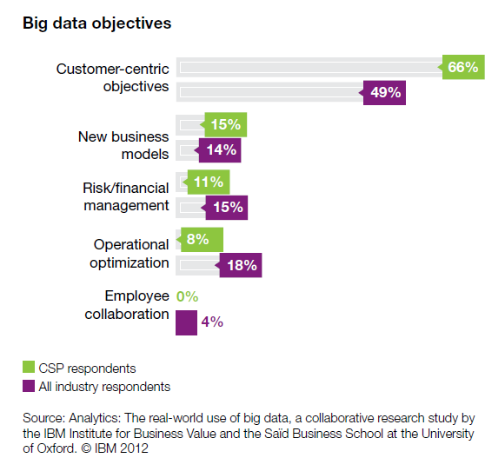
Business Direction
Notes:
Whether CSPs are using big data to support their core
business, or are considering big data sales as a source of
revenue, they need to develop a roadmap, set up an adequate
infrastructure and adopt new methods, processes and tools to
manage the unique volume, velocity, variety and veracity
requirements of big data. By analyzing survey responses, five
key findings emerge that reveal common insights and trends:
• The business case for big data is strongly focused on
addressing customer-centric objectives
• A scalable and extensible information management
foundation is a prerequisite for big data advancement
• CSPs are beginning their pilots and implementations by
using existing and newly accessible internal sources of data
• Advanced analytic capabilities are required, yet often lacking,
for CSPs to get the most value from big data
• The emerging pattern of big data is focused on delivering
measurable business value.

Slide 19
Customer-centric Objective
Telefonica’s Brazillian subsidiary, Vivo
Offer discounted upgrade options
“Smart Steps.”
Tailor local offering for existing stores.
Verizon’s Precision Marketing division
➔Joint promotional opportunities and ticketing packages
Notes:
For example, Telefónica’s Brazilian subsidiary, Vivo,
implemented a solution that uses call data, demographics and
predictive modeling to reach out to customers and only offer
them products and services that match their needs and
lifestyles.
This can preemptively
contact customers who have recently exceeded their allotted
calling minutes and offer discounted upgrade options that
will prevent future overages.
This approach demonstrates to
the customer that Vivo values their business and is likely to
result in a positive customer experience. These types of
customized marketing promotions can help to prevent
churn, increase sales and lower marketing campaign costs.
Telefónica’s Dynamic Insights division launched its first service
in November 2012: “Smart Steps.”
This service is designed to
provide insights to retailers to help them tailor local offerings
for existing stores, and determine the best locations and most
appropriate formats for new stores.
Verizon’s Precision
Marketing division has already trialed its solution with a sports
team. Joint promotional opportunities and ticketing packages
have boosted season ticket sales by up to 35 percent

Slide 20
Risk & financial management Objective
Using real time analytics tools could reduce fraud by more than US$100 million per year.
For example:
T-Mobile ➔ high-value subscribers and services to better target its capital expenditure and networking engineering.
Notes:
One CSP executive estimated that using real time analytics tools could reduce fraud by more than US$100 million per year.As well as driving down overall debt-collection costs, targeting risky customers also has the added advantage of lowering churn rates.
T-Mobile in the United States, for example, is collecting a
staggering 17 billion events a day from its network, storing this
data and running analytics on it.16 This analysis enables
T-Mobile to examine and correlate network performance with
high-value subscribers and services to better target its capital
expenditure and networking engineering.

Slide 21
Non-traditional source of INFO
Monthly account-management cycle
➔ XO communication .
Social media content
➔
Notes:
XO Communications, a wholesale and enterprise-focused CSP
in the United States, has been using predictive analytics with
its monthly account-management cycle to predict churn.
Within the first year, a 60-percent improvement in revenue
retention rates was realized.
By
combining social characteristics with existing behavioral
knowledge, CSPs are able to create extended and deeper
insights to engage and retain customers. Social network
analytics can also be used to find key influencers and engage
them with customized messaging, to evaluate how new
campaigns, product and services are resonating, and to quickly
respond to negative chatter to protect their brands and
reputation. Bharti Airtel, for example, uses social network
analysis to determine customer issues by tracking mentions of
the company on social media and following up on any
problems.

Slide 22
Partnership
Notes:
Possibilities abound for CSPs to partner with other parties.
For example, they can team up with advertisers, retailers, car
manufacturers and public administrations – just to mention a
few – for e-commerce, machine-to-machine applications and
location-based services. They can play a role in smarter cities,
health care and other areas, both in mature and growth
markets. France CSP Orange, for example, recently
participated in an experiment called “Traffic Zen” with
highway operator Autoroutes du Sud de la France to create
traffic forecasts.9 And, as previously mentioned, some CSPs
have had success in selling data to marketing agencies.10

Slide 23
Reference:
1. Big Data Working Group: Big Data Analytics for Security Intelligence. (Sep 2013) - Cloud Security Alliance
2. Big Data and Advanced Analytics in Telecom: A multi-billion-dollar revenue Opportunity. (Dec 2013) - Heavy Reading
3. https://www.pitneybowes.com/pr/articles/how-location-intelligence-is-reshaping-three-different-industries.html
http://www.rcrwireless.com/20141014/big-data-analytics/telco-case-study-vodafone-argyle-data-tag6
https://www.kit.nl/biomedical-research/kit-news/big-data-location-based-applications/
http://www.informationweek.com/big-data/big-data-analytics/cisco-brings-location-based-big-data-to-shopping/d/d-id/1107407?
http://dynamicinsights.telefonica.com/wp-content/uploads/2015/04/O2-Retail-Smart-Steps-Case-Study.pdf

